Slide 1

Ethics in AI Health
Ying Ding, school of Information, dell medical school, ut Austin

Slide 2
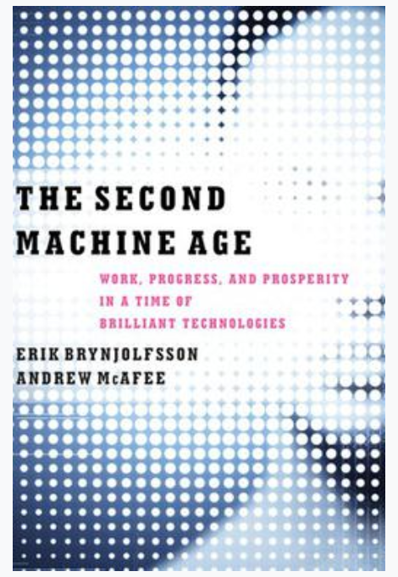
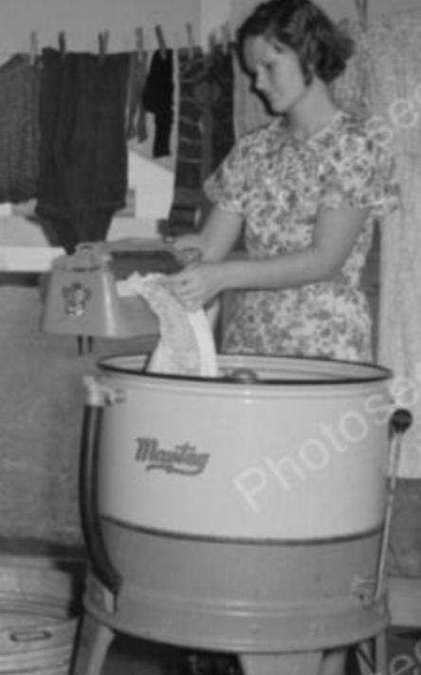
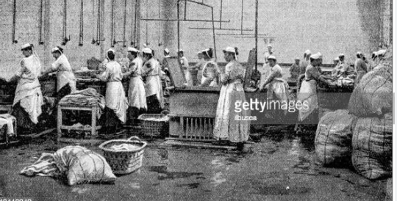
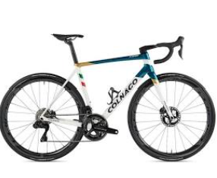
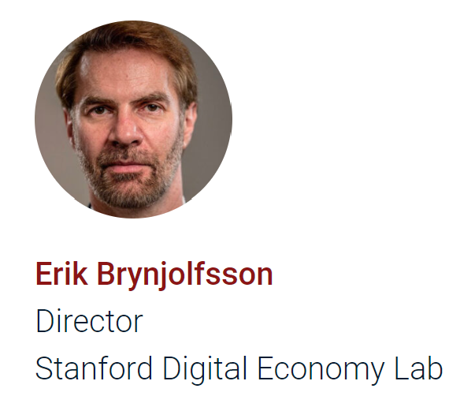
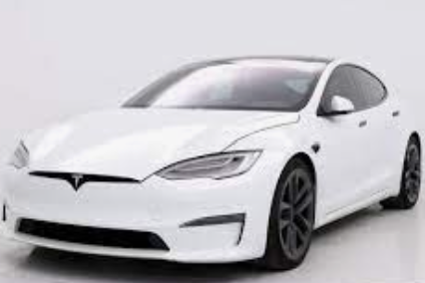
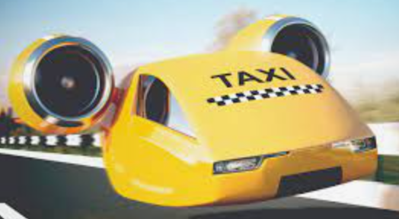

Mindset shift: augment vs. automate/replace
Augment
Bike
Car
?? (Happy to be replaced)
Washing machine
Dishwasher
Automate/Replace
Driverless Car
ChatGPT

Slide 3


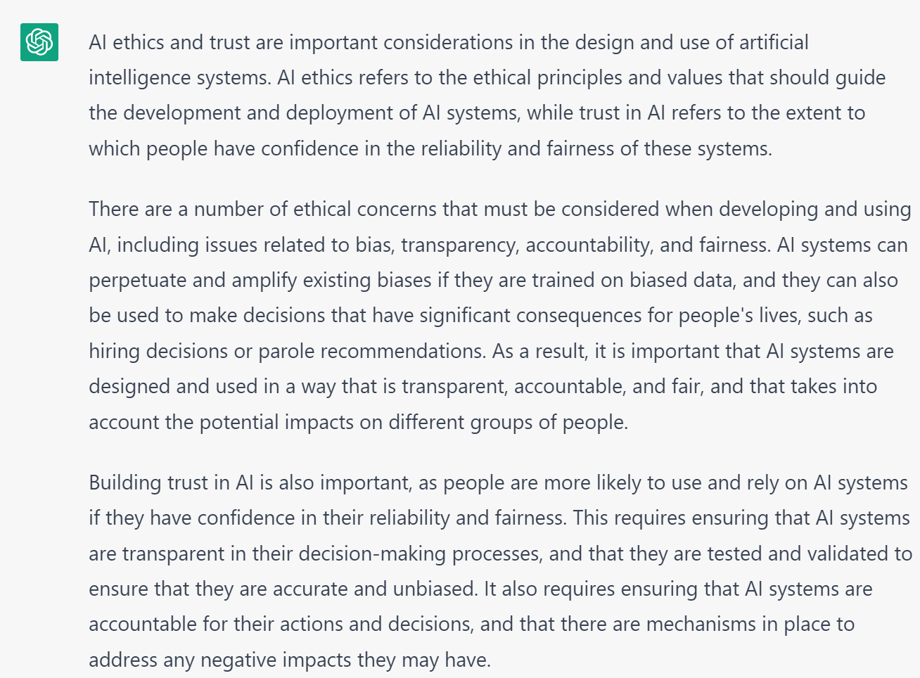
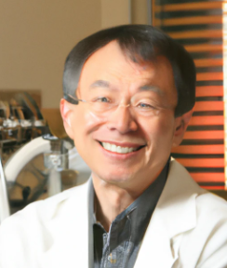




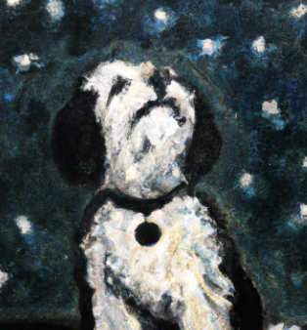
Human privileged skills
Narrow AI vs. General AI
Thinking
Creating
Judging
Deciding
Diagnosing
Inventing
Aggregating info to make decision: Leap vs. Step

Slide 4

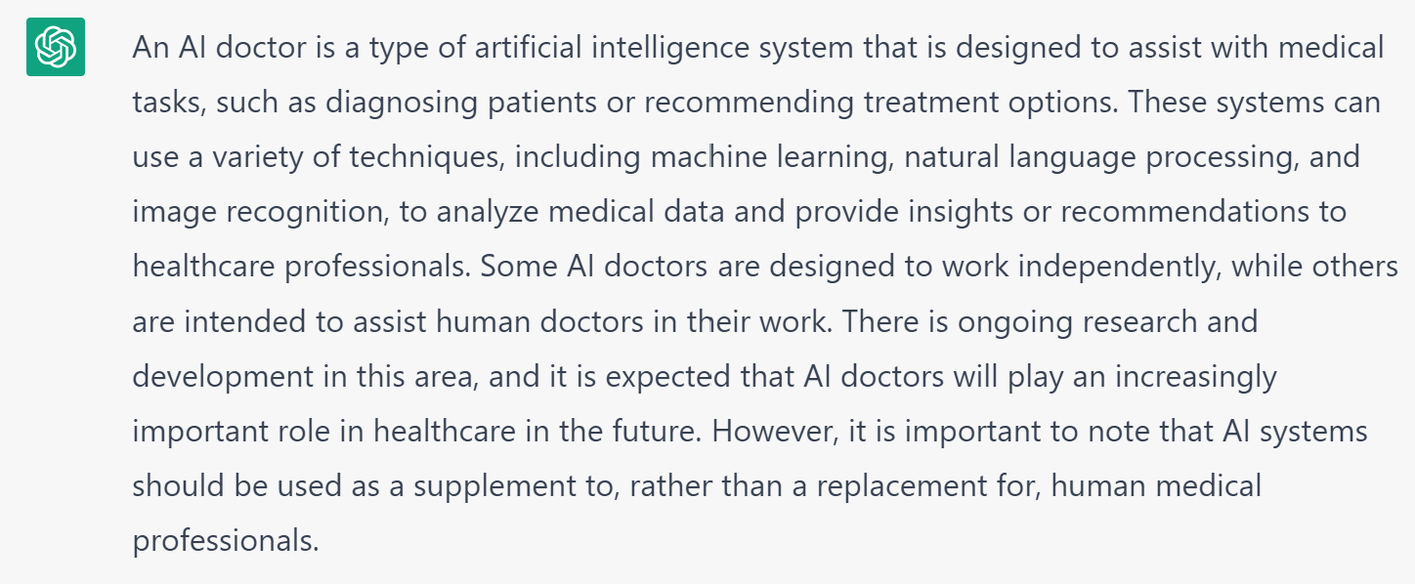
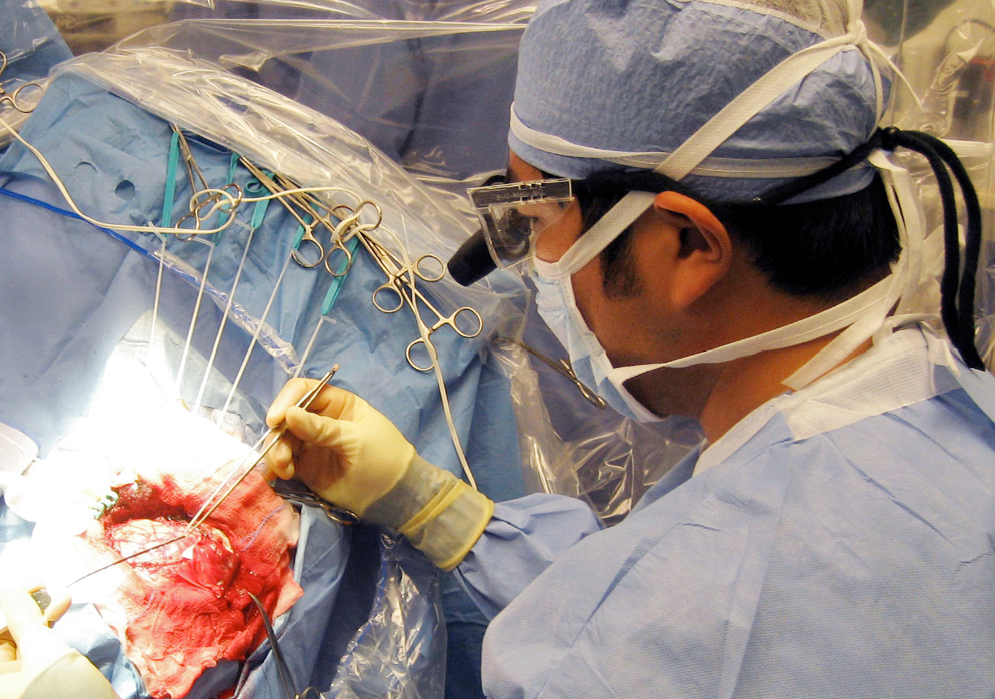
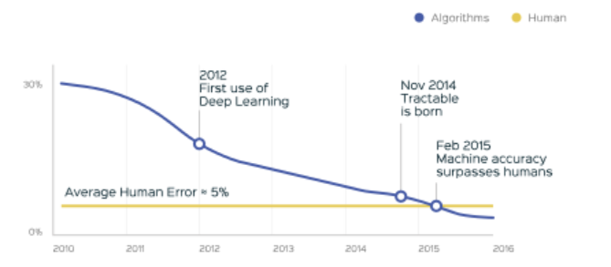
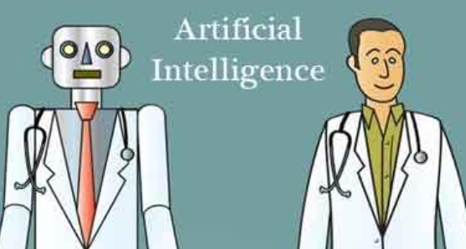

AI doctor vs. human doctor

Slide 5
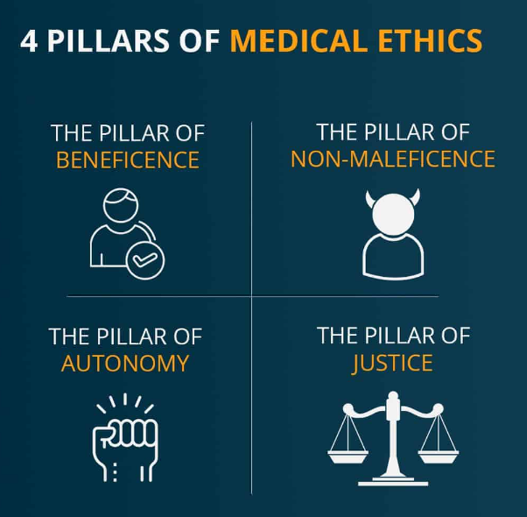
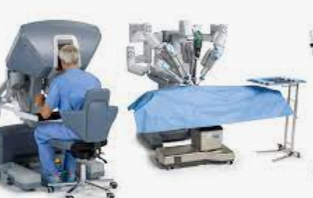
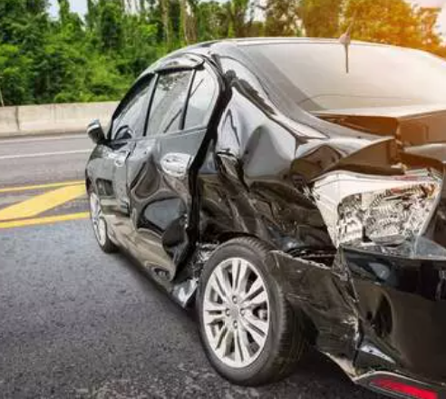
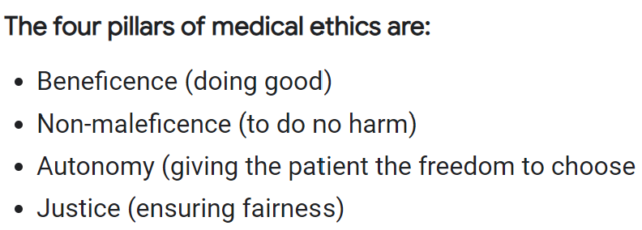
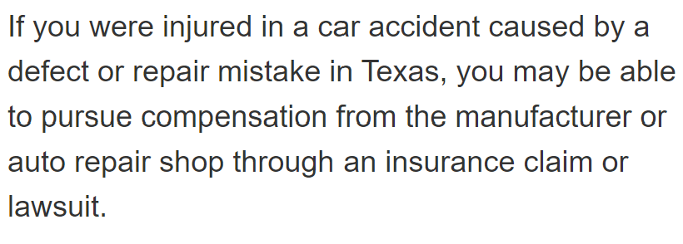
In god we trust! in ai we trust? Whom to blame
AI does not have the capacity to be trusted because it does not possess emotive states or be held responsible for its actions → requirements of the affective and normative accounts of trust.
AI does meet all the requirements of the rational account of trust → a form of reliance.
Rational trust is that the trustor is making a logical choice
German philosopher Martin Heidegger said that the human-technology relationship oscillates between suspicion and reliance.
Being trustworthy
https://link.springer.com/article/10.1007/s11948-020-00228-y
https://link.springer.com/article/10.1007/s43681-022-00200-5

Slide 6
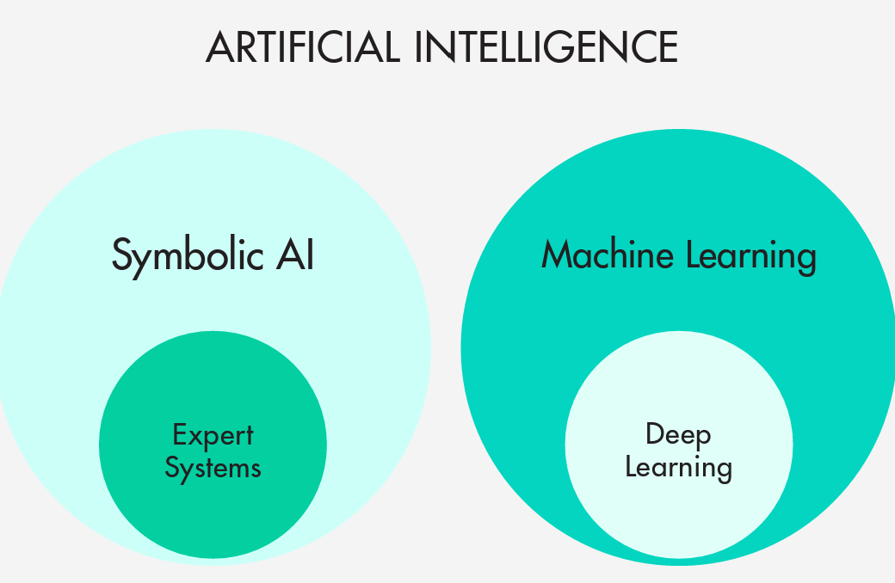
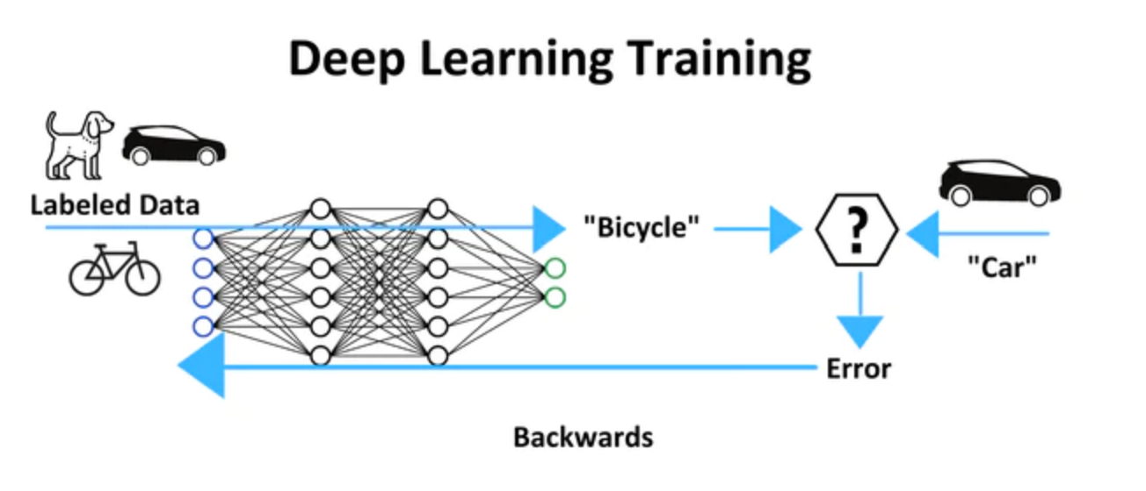
Ai in healthcare
AI can diagnose skin cancer better than board-certified dermatologists
Chatbots are used to dispense medical advice in lieu of nurses
Machine learning methods for sepsis prediction
Medical imaging diagnosis
Surgery robots
Genomic biomarker identification for cancer patients
Stroke diagnosis
Medical notes summary
Drug discovery
Clinical trials
Hospital management
Personalized care management – health insurance company
Data Bias
Model Transparent
Result Interpretation – Contextualization/Personalization
Whether AI can use data safely, securely, and appropriately and to be deployed ethically and effectively

Slide 7
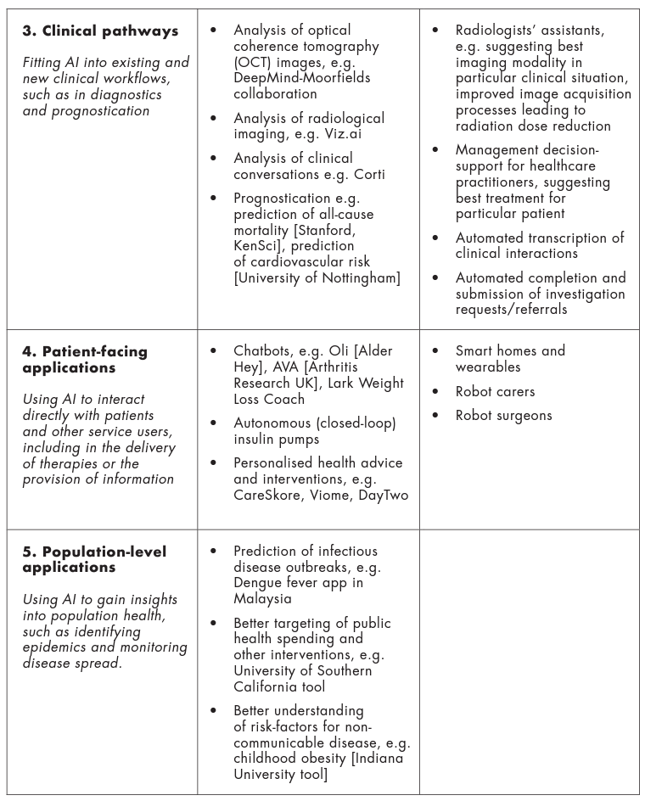
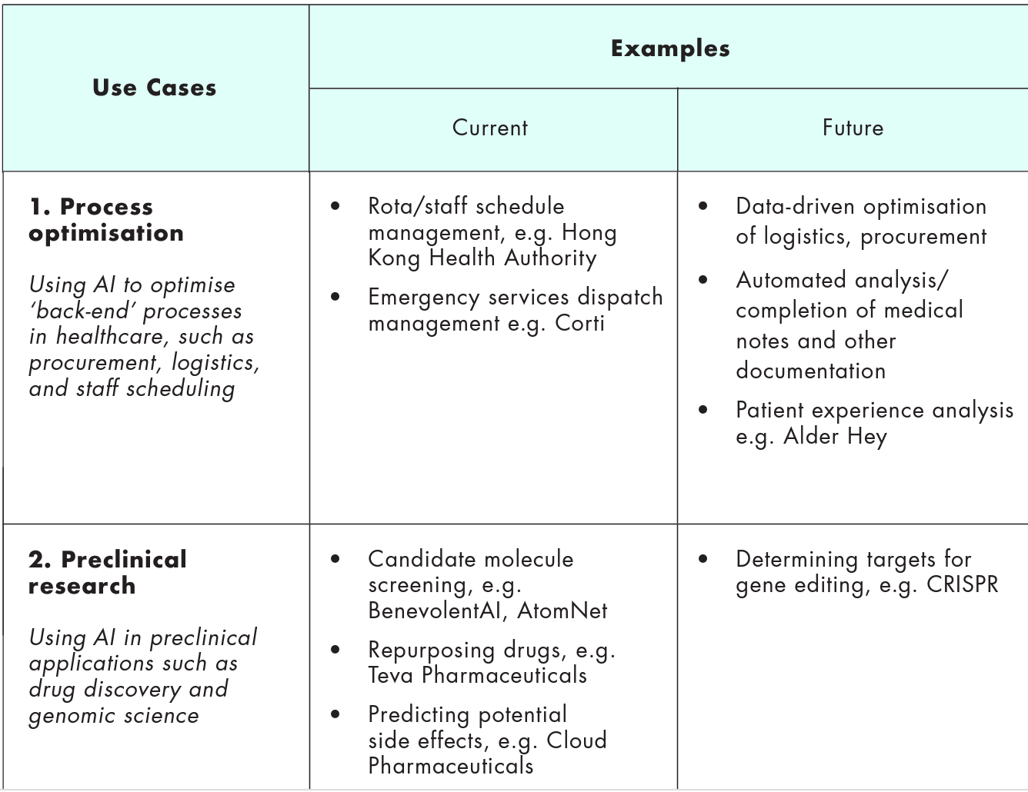
Ai in healthcare
https://wellcome.org/sites/default/files/ai-in-health-ethical-social-political-challenges.pdf

Slide 8
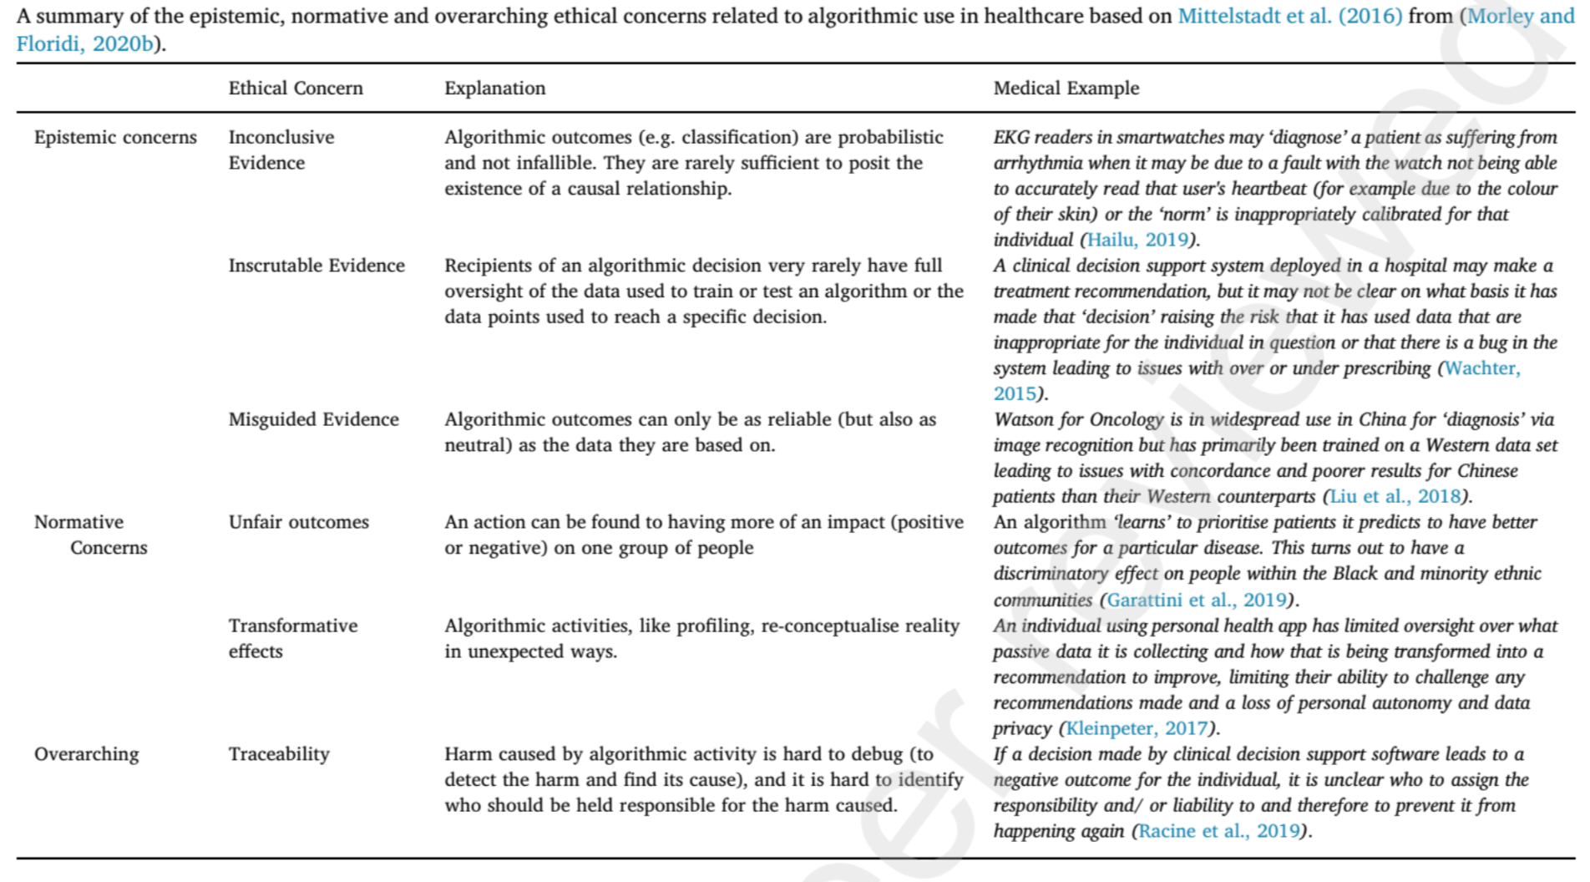
Morley, J., Machado, C. C. V., Burr, C., Cowls, J., Joshi, I., Taddeo, M., & Floridi, L. (2022). The ethics of AI in healthcare: A mapping review. https://papers.ssrn.com/sol3/papers.cfm?abstract_id=3830408

Slide 9
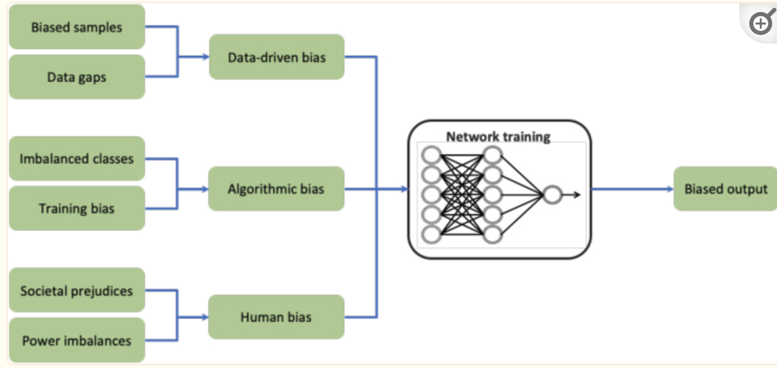
Data Bias and trust: translational
Bias in patient population distribution
Rare diseases
Lack of high-quality annotated data
Data privacy and sharing
Cross-modality of data: table, text, image, wave
Missing data
Genomic data (cannot be de-identified)
Not all data are created equally
Data Governance
Data Standard
African-Americans comprise less than 5% of clinical trial participants and Hispanics just 1%, in spite of the fact that they represent 12% and 16% of the total US population respectively.

Slide 10
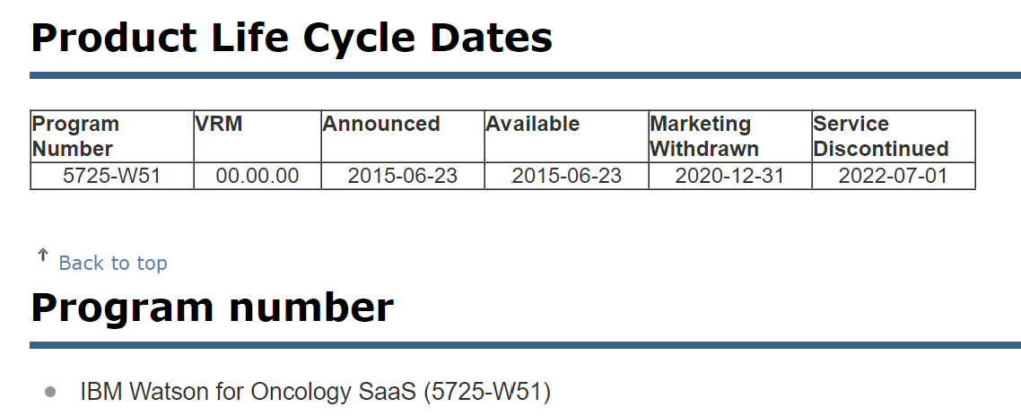
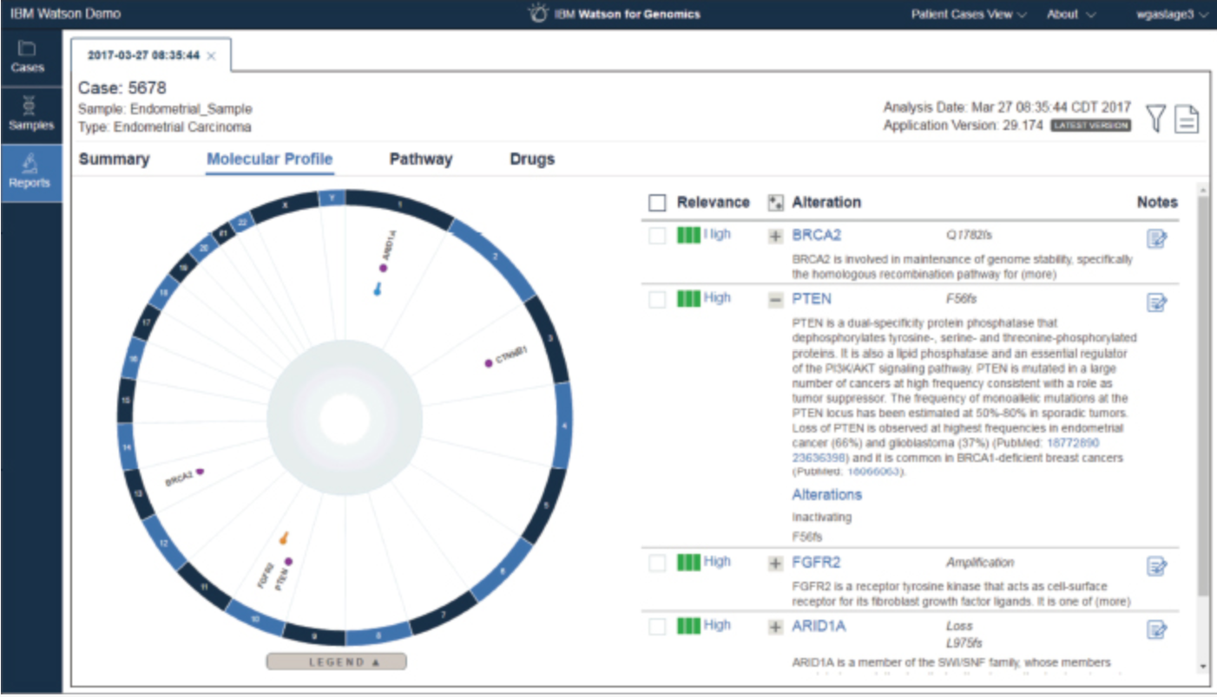
The fall of IBM’s Watson Oncology
In 2012, IBM closed a deal with Memorial Sloan Kettering, one of the preeminent cancer centers in the country, to train an AI to make treatment recommendations.
Truven, Phytel, Explorys and merge. Truven had the biggest insurance database in the nation with 300 million covered lives, Explorys provided a clinical data set of actual electronic health records kept by health systems representing about 50 million or so patients, Phytel added on top of that, and Merge had a huge imaging database. They had all this data and the idea was: Expose Watson to that, and it finds patterns that physicians and anyone else can’t possibly find when looking at that data, given all the variables in it.
https://slate.com/technology/2022/01/ibm-watson-health-failure-artificial-intelligence.html

Slide 11
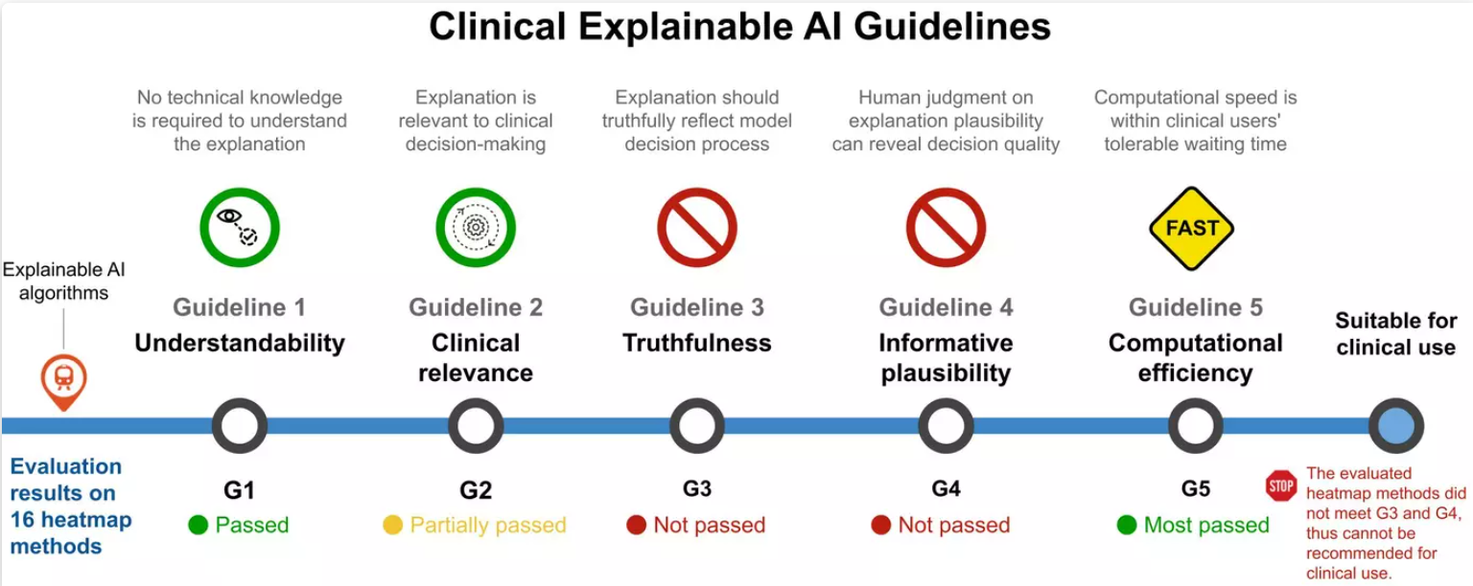
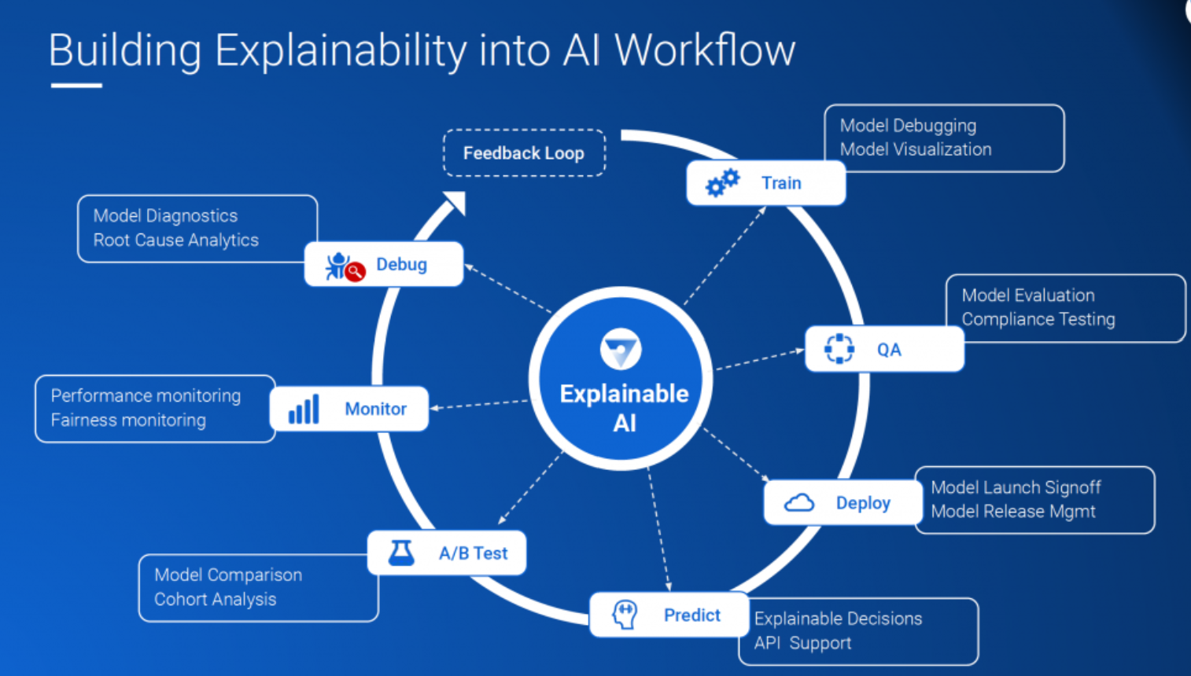
Algorithm Transparency: explainability
Is this human ‘black box’ very different from the algorithmic black box?
The right to explanation
Different users and different situations will require different things in terms of explainability.
Counterfactual explanations: what if, why not,
Decisions are based on a combination of information and preferences, user preferences are ignored.
Human error vs. algorithmic error: we hold algorithms to a higher standard than we hold humans
Court: judge decisions/actions as negligent or malicious through court discussion and human explanation, but machine cannot join court discussion
Interaction: itself is a process of explanation
https://weina.me/clinical_xai_guideline
https://www.uxai.design/design-strategy
https://www.fiddler.ai/blog/explainable-ai-goes-mainstream-but-who-should-be-explaining

Slide 12
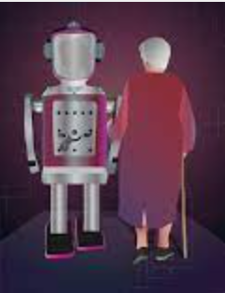
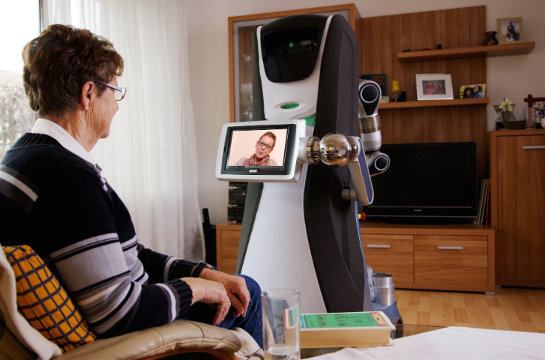
Contextualizing AI results: Ethics of Carebots
Balancing: Overmedicalising healthy people, causing anxiety – prediabetes
Localization or personalization: from generalization (what AI is good at) to degeneralization (what AI is not good at)
Ethics of Carebots:
infringements of privacy
Deception for early with dementia
Overreliance and attachment
maintenance of trust
Deontology: issues of autonomy, dignity, deception, and social isolation
Health disparity: affordability of carebots
Human Dignity
Who is to be held accountable if a care receiver takes his own life under the watch of a care robot which is an autonomous agent.
https://www.ncbi.nlm.nih.gov/pmc/articles/PMC7245509/

Slide 13
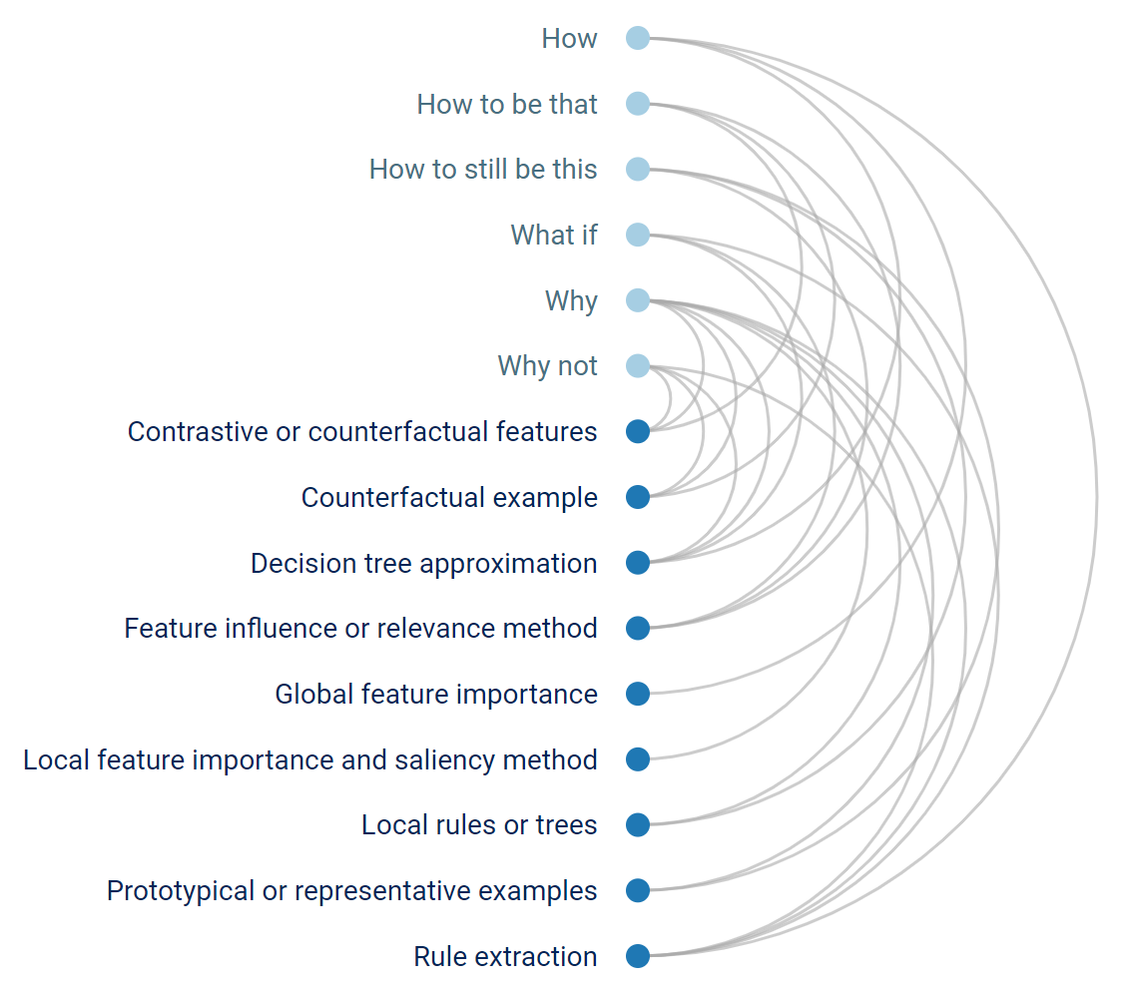
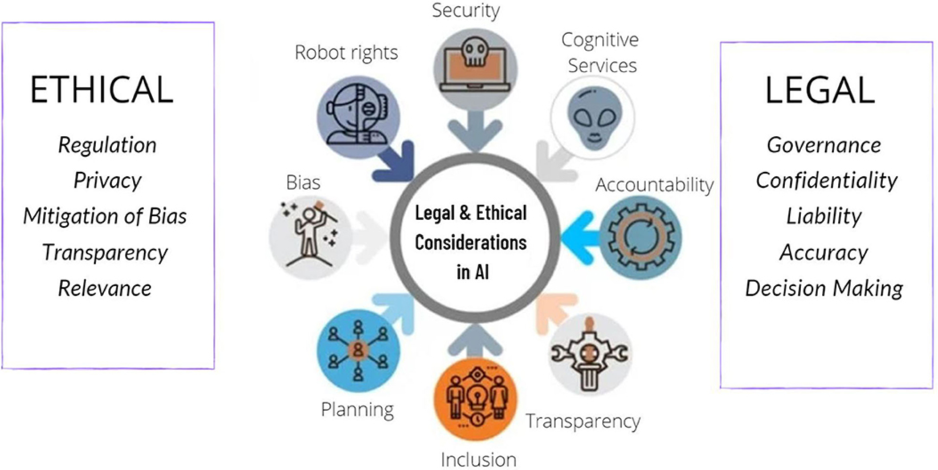
Design: a trust bridge between AI, doctor, and patient
Including end-users (e.g., clinicians) in the design of AI in healthcare
Being explainable and transparent on AI technologies
The involvement of end user in the design can reinforce transparent development process.
Ethical Design
top-down: embedding ethical principles into AI algorithm
bottom up: AI algorithm adapts and learns an external set of principles based on the observations of humans
technomoral care: skillful, attentive, responsible and emotionally responsive disposition to personally meet the needs of others who share our technosocial environment
https://www.uxai.design/design-strategy
https://www.frontiersin.org/articles/10.3389/fsurg.2022.862322/full

Slide 14
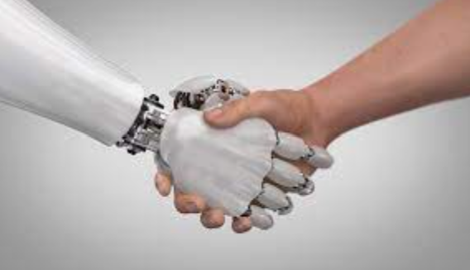
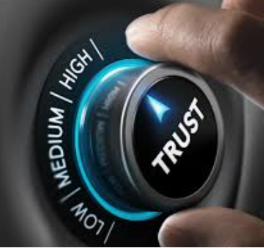
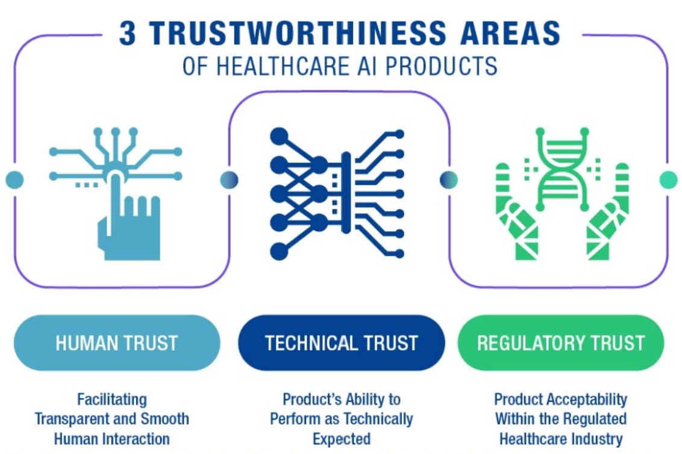
demistifying ai
Trust is a relational and normative concept.
Trust implies some uncertainty or risks
Human and Technology Trust: iterative process of testing and evaluating
Trust is a dynamic process
Communication
Education
Governance: developing policy to address ethical, social, and legal issue
Regulation: continuous certification for AI
Monitoring: learning, adapting, and mitigating bias

Slide 15
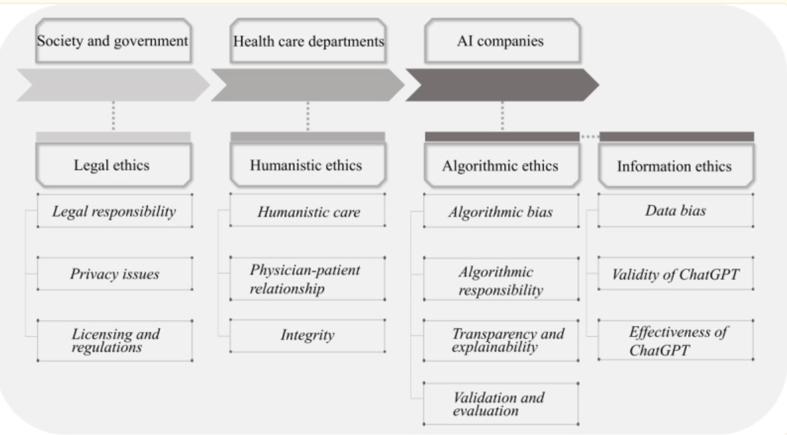
ChatGPT and Ethical AI in Healthcare
ChatGPT may need to hold a valid license and comply with specific regulations governing their practice.
Humanistic ethics should guide the use of ChatGPT in health care, emphasizing the importance of a person-centered approach.
Mitigate the potential “automation bias” that can result from overreliance on algorithms
https://www.ncbi.nlm.nih.gov/pmc/articles/PMC10457697/#:~:text=ChatGPT%20presents%20potential%20ethical%20challenges,privacy%20due%20to%20data%20collection.

Slide 16
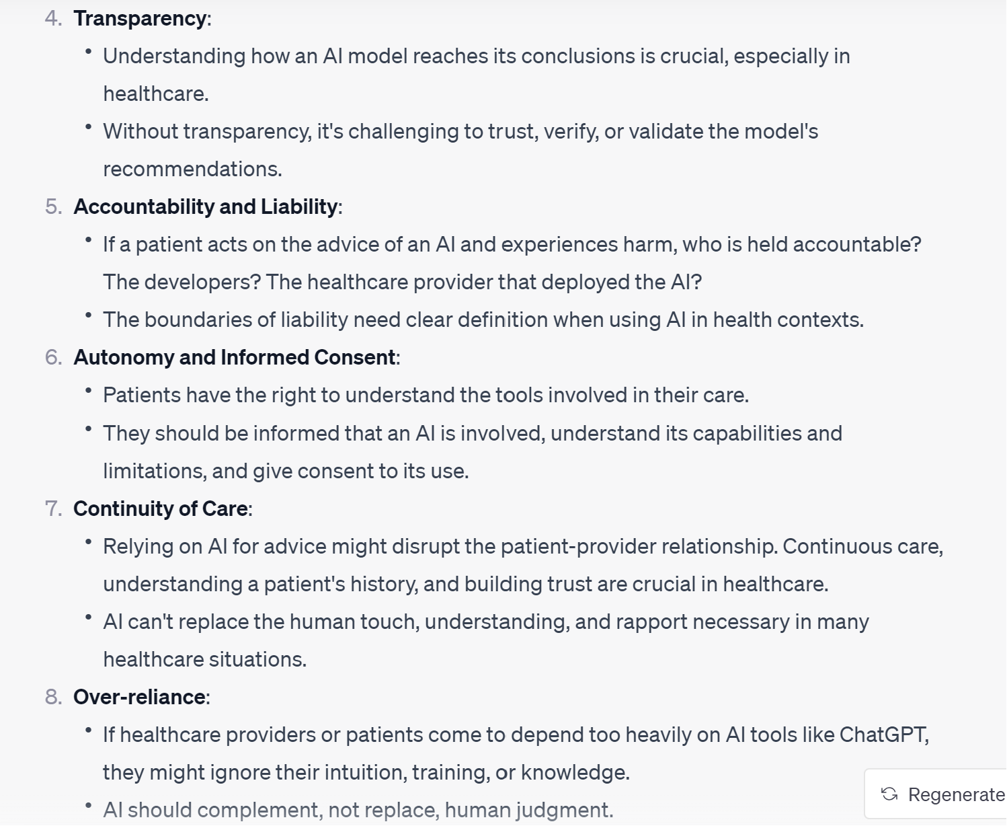
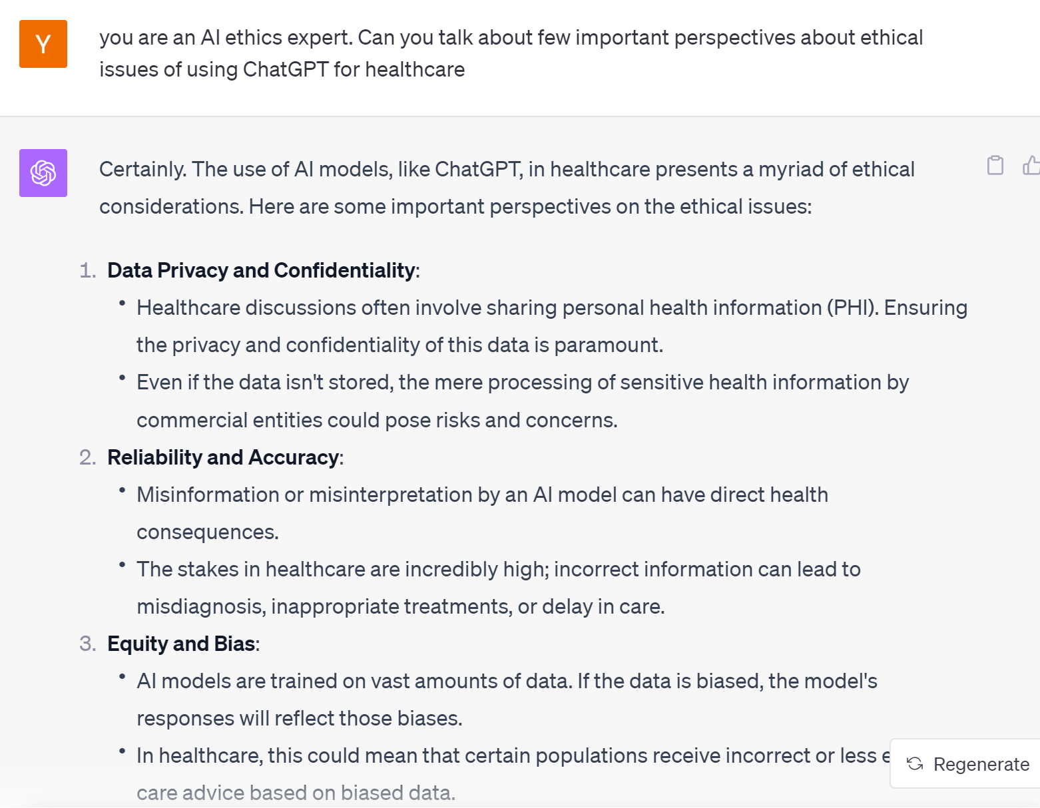
How ChatGPT thinks about this

Slide 17
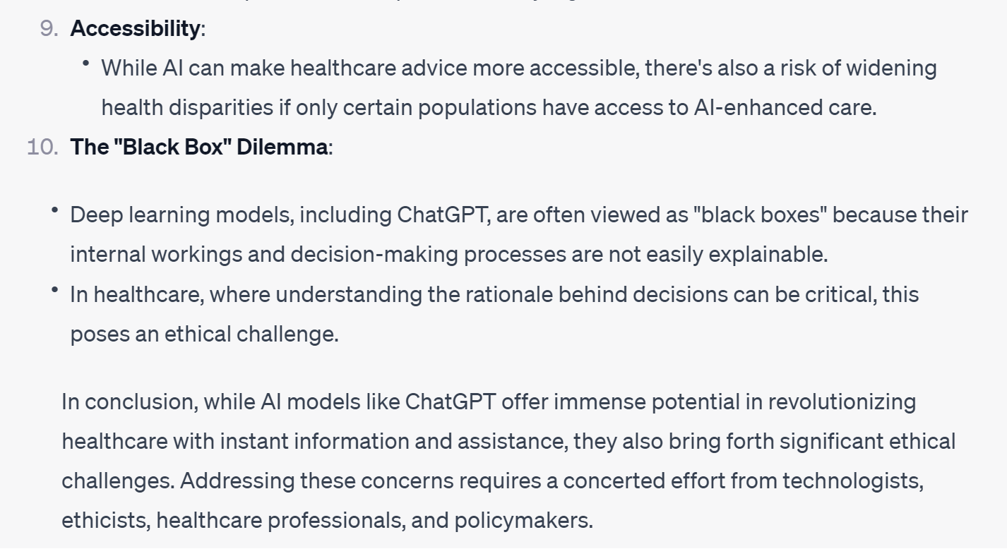
How ChatGPT thinks about ethical ai in healthcare

Slide 18
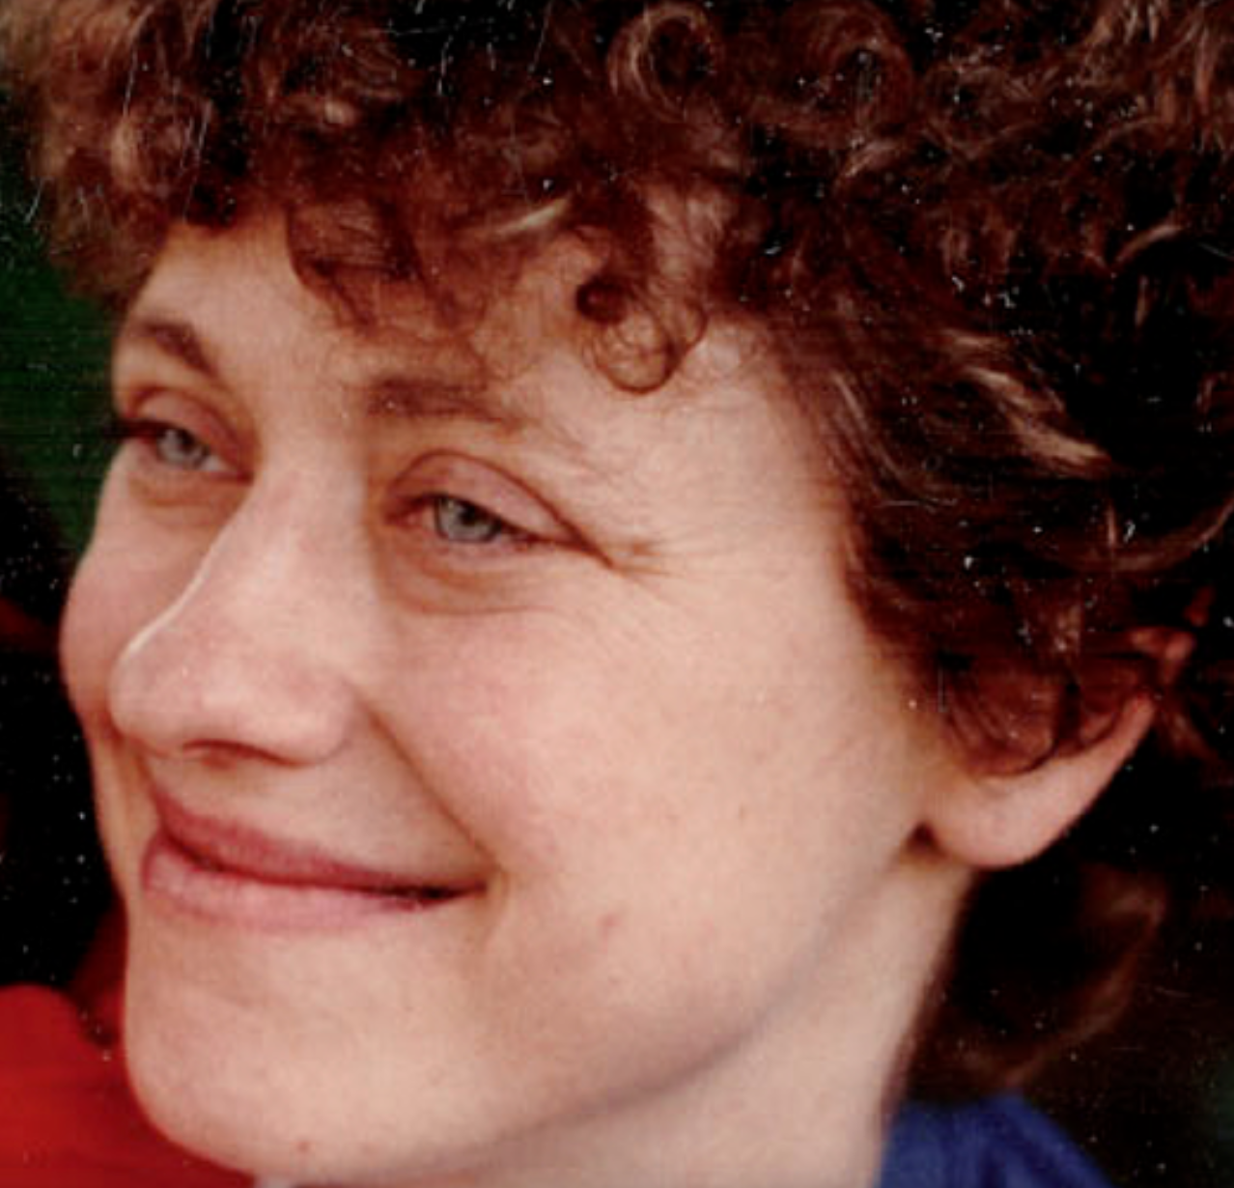
Long way to go
In 1994, Betsy Lehman, a reporter of Boston Globe and mother of two young girls, was battling advanced stage of breast cancer. She was killed by the four times the intended dose of a powerful chemotherapy drug at Dana-Farber Hospital (the world premier cancer center). – Betsy Lehman Center
https://betsylehmancenterma.gov/

